Slide 1
Hello, World!
IDC Cancer Detection using WideResNet made easy with Deepcognition.ai

Slide 2
STEPS
Go to deepcognition.ai and create a new project.
Select Kaggle_IDC_Cancer dataset keep the default split and choose full dataset if you have enough resources.
Create the model using drag and drop options from the left side.
Select the GPU (I used GPU-K80-12GB ($0.9/hr)), start the training (wait....).
Check the Results.
You can also save the model.

Slide 3
Screenshots
Project
Data
Model
Hyper Parameters
Training Loss & Accuracy
Validation Loss & Accuracy

Slide 4
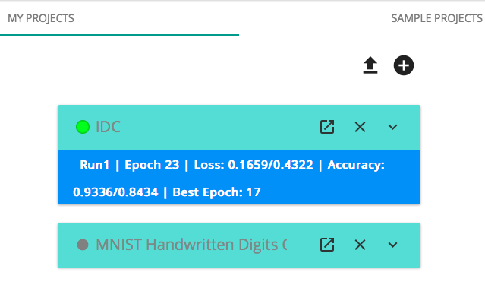

Slide 5
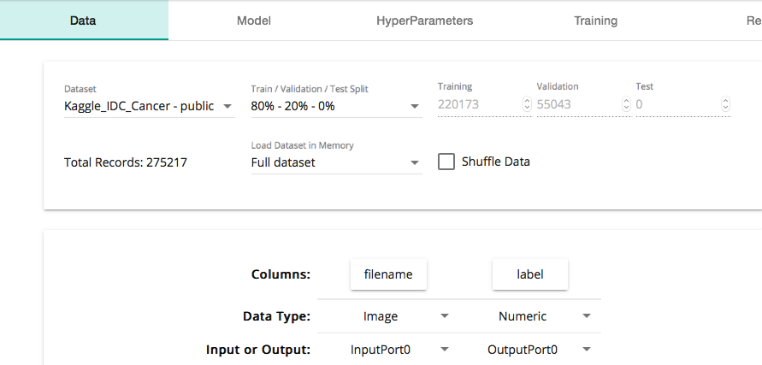

Slide 6
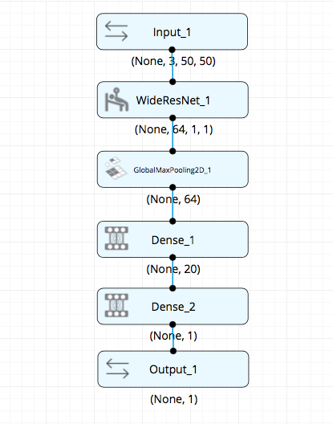

Slide 7
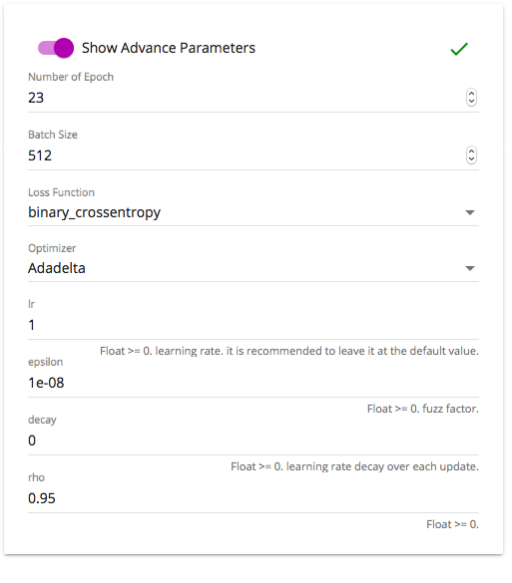

Slide 8
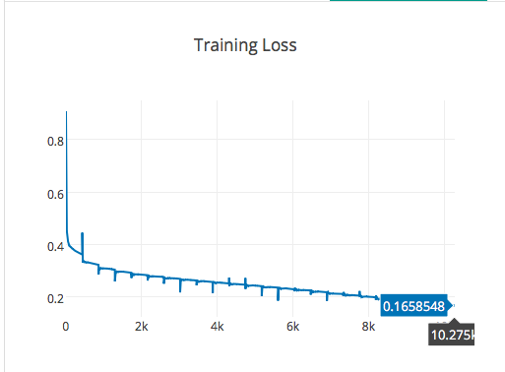

Slide 9
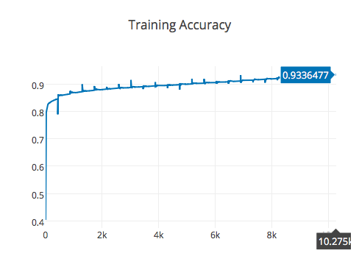

Slide 10
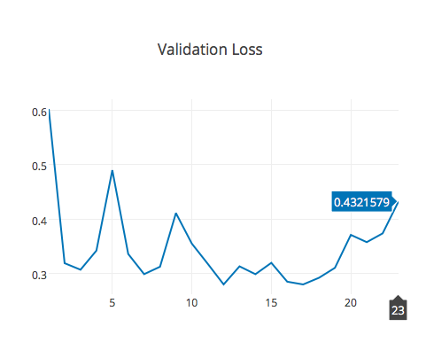

Slide 11
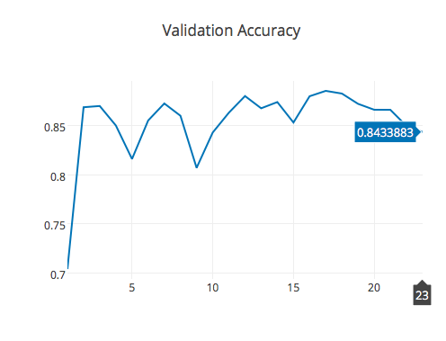

Slide 12
Results
Metric | Result (%)
Training Loss | 0.1658548
Training Accuracy | 0.9336477
Validation Loss | 0.4321579
Validation Accuracy | 0.8433883

Slide 13
Presented by Akansha Jain
This presentation was made using python ♥

